Slide 1
CICD Via Concourse

Slide 2

Omar Mahdi
Previously an intern at the Institute of Applied Information Technology (InIT Lab) at ZHAW
Worked on DevOps, application development, research and as a lab assistant
Setup the current Cloud Foundry (PaaS) installation and a number of supporting services, all automated using Concourse
Developed the only (to our knowledge) open source service broker that provides S3 and Swift object storage through Ceph
Currently researching Unikernel technology focusing on PaaS and FaaS systems

Slide 3
Outline
A High Level Look at CICD
The Concourse CICD System
General Operation
The anatomy of Concourse Pipelines

Slide 4
A High Level Look at CICD

Slide 5
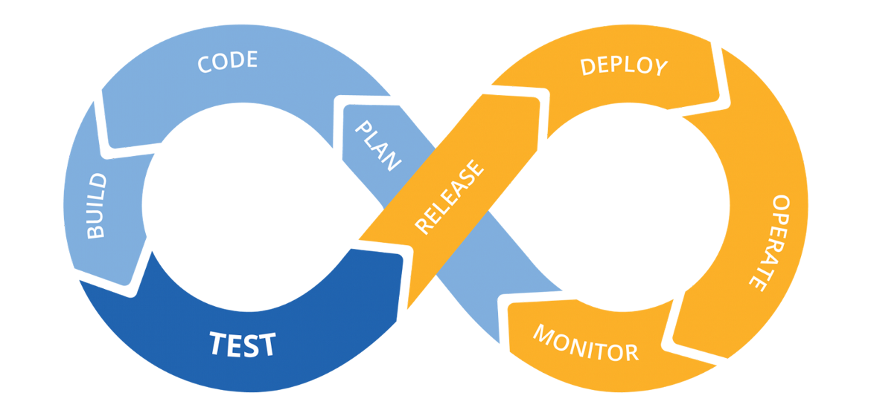
What is CICD?
Continuous Integration/Continuous Deployment, commonly known as CICD, is part of the DevOps software development methodology
It is a practice that focuses on using automation to make building, testing, deploying and integrating different components of a program or service autonomous and reproducible

Slide 6
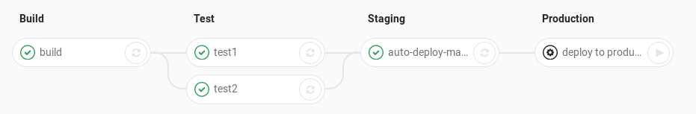
Basics of a CICD Pipeline
In a general sense, any CICD tool consists of a ‘Pipeline’ that is made up of ‘Tasks’ or ‘Jobs’ that do some operation and can either ‘Pass’ or ‘Fail’
Pipeline are usually started automatically by some operation, for example by a new GitHub commit, although some tools allow manual start of pipelines and jobs
When a pipeline starts, it starts the first job(s), and then when a job completes and successfully passes it starts the next job(s)
Jobs can usually run arbitrary code and can run sequentially or in parallel

Slide 7



Popular CICD Tools
Jenkins, Concourse and Travis CI are among the most used CICD tools, with Concourse being the newest among them and the one we will look at
Jenkins and Concourse are open source, while Travis is free for open source projects
They all allow you to write your jobs in many programming languages, and different jobs can usually use different programming languages
All of them also provide elegant UIs for monitoring and starting jobs and reviewing job logs

Slide 8
The Concourse CICD System

Slide 9
What is Concourse?
Concourse is a modern, open source CI/CD system designed to be simple, stateless and includes a clean, easy to use UI to visualize your CI/CD pipelines and logs
Concourse is based on three simple concepts: Resources, Tasks and Jobs
It is built on containers and allows you to specify your own docker images, making it extremely flexible and able to use any programming language
Additionally, custom resources allows you to abstract out common functionality and reuse it across pipelines

Slide 10
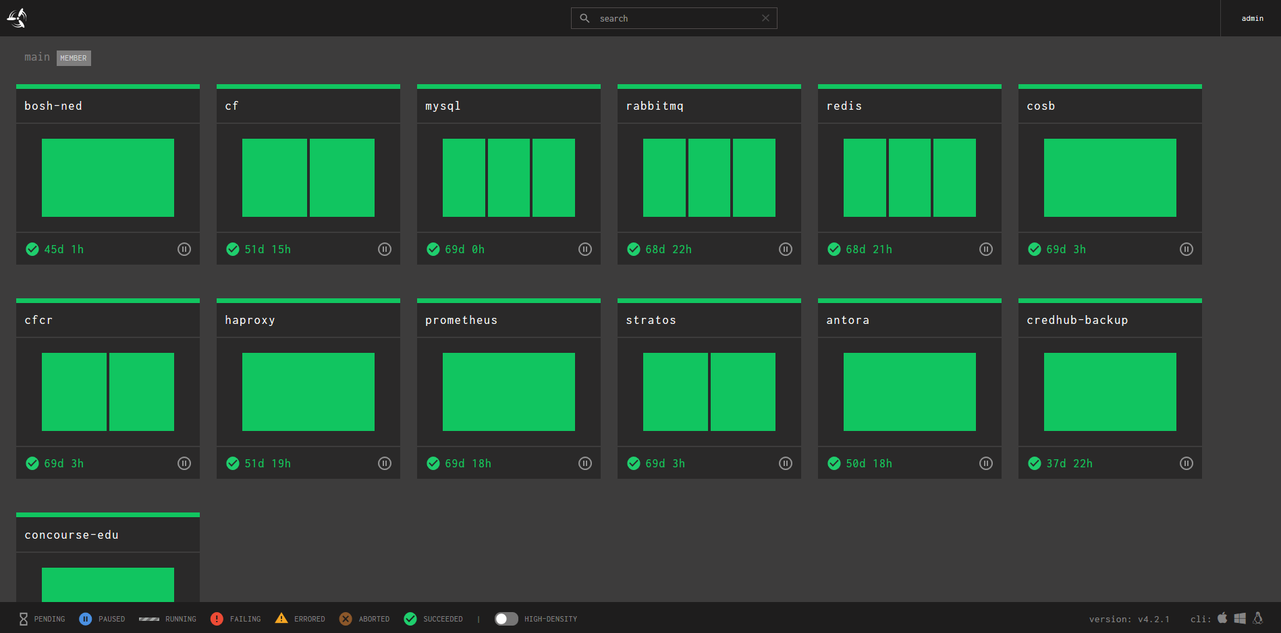
Different pipelines
Each box is a different job

Slide 11
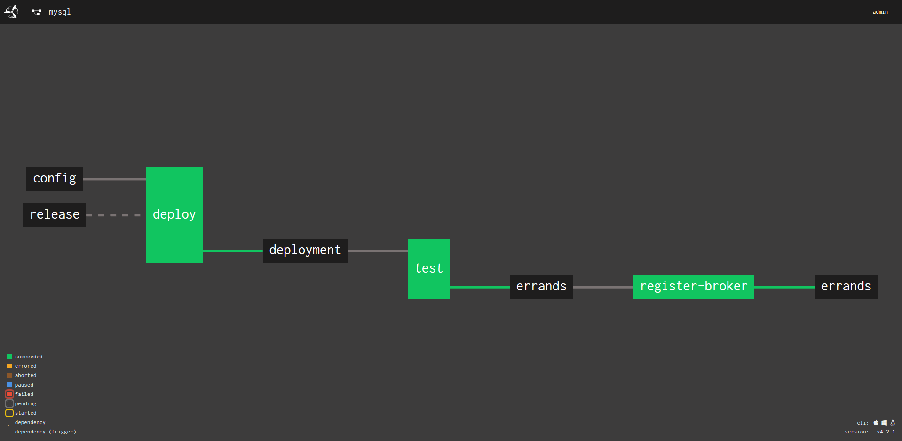
Solid line means this resources automatically starts its job
Resource
Output resource can be input to another
Job

Slide 12
General Operation

Slide 13
General Operation
Fundamentally, a Concourse pipeline functions via the following steps:
A job is triggered manually or automatically by a new version of a resource it uses
The job retrieves the resources it wants to work on (e.g. clone a git repo)
Some resources might only be used for triggering a job (e.g. a timer)
Job uses the resource in some way by running a task (e.g. builds the cloned repo)
The job produces a resource as output (e.g. deploys built program)
A resource can be anything but always provides ‘check’, ‘in’ and ‘out’ operations
E.g. A Git repository that can be checked for commits, cloned (in) and pushed to (out)
Jobs are simply user defined containers that can run scripts and interact with resources

Slide 14
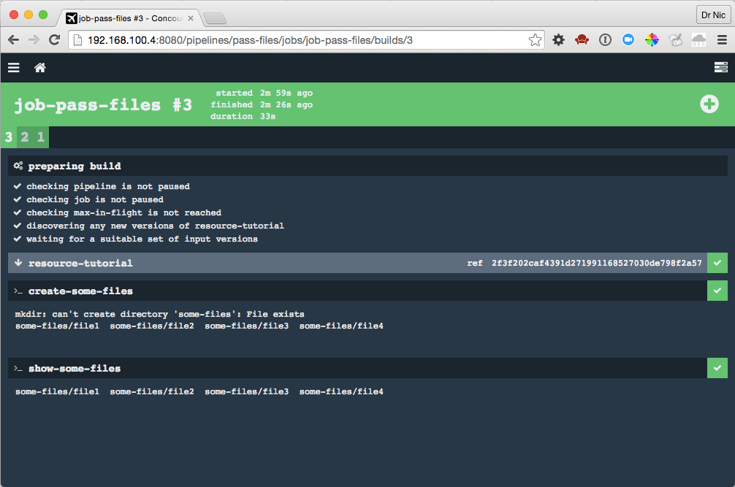
Resource version
Resource
Task 1
Task 1 Output
Task 2

Slide 15
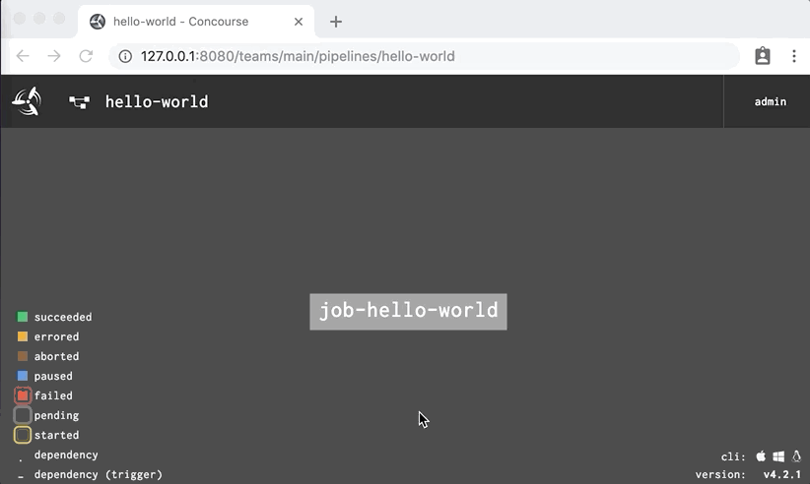
Job Without Resources (Completely Manual)

Slide 16
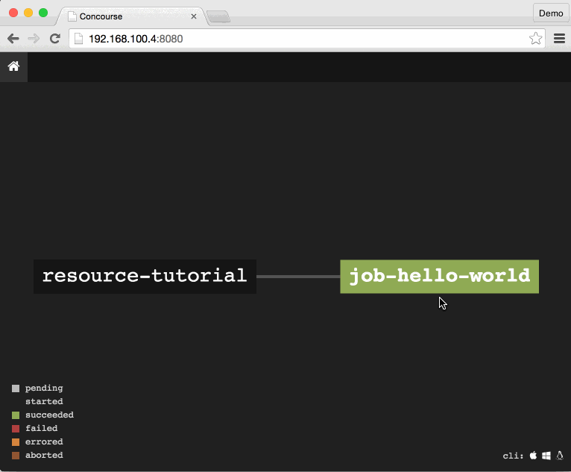
Triggered Job (Automatically Started by Resource)

Slide 17
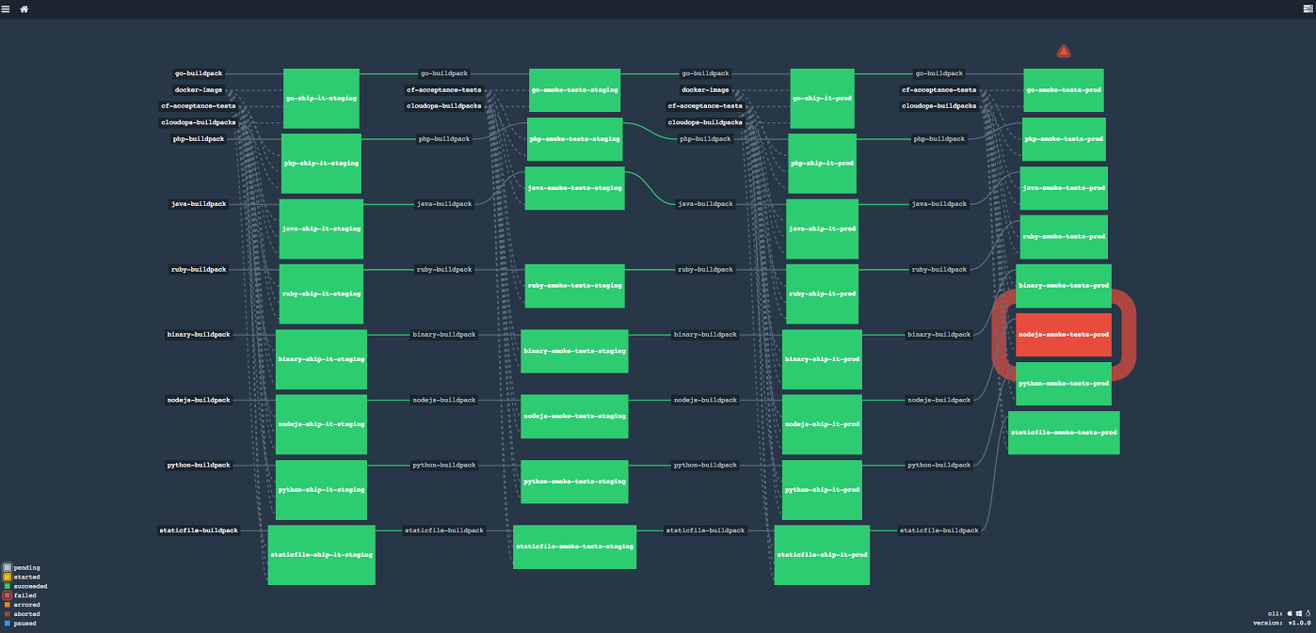
A ‘Slightly’ Bigger Pipeline

Slide 18
The Anatomy of Concourse Pipelines

Slide 19
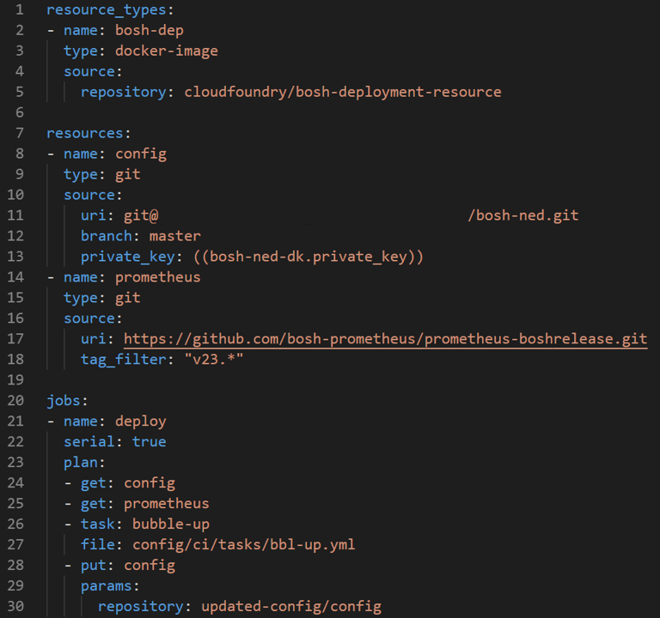
Pipelines - Manifest
Custom resource types
Actual resources
Jobs
2 Input resources to the ‘deploy’ job
1 Task defined in a file
1 Output resource

Slide 20
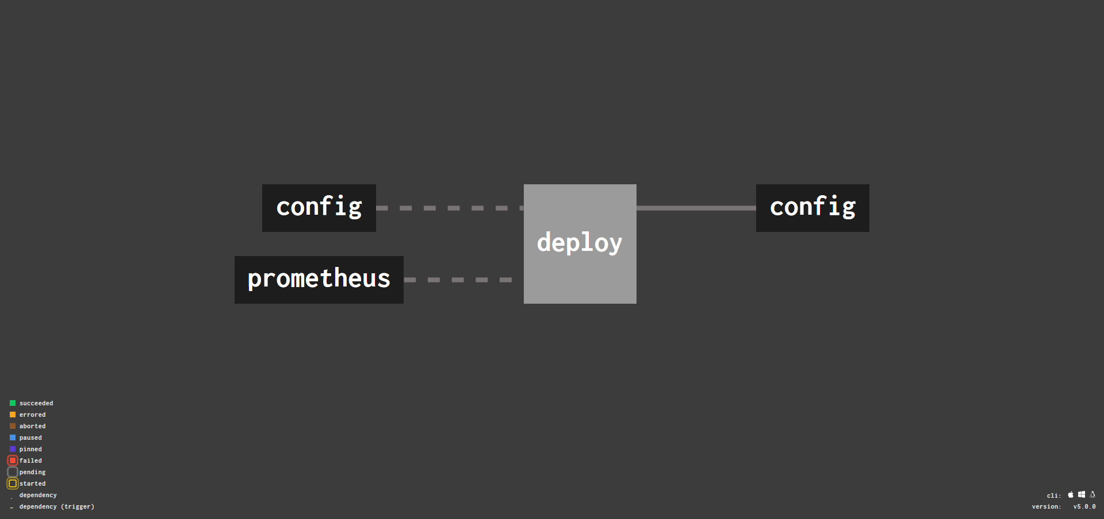
Pipelines - Manifest

Slide 21
Pipelines - Resources
Resources can simply be described as ‘versioned objects’. Their generic nature makes them very powerful and allows Concourse to be a general automation system
They can also be thought of as dependencies for your pipeline, as they can act as inputs, outputs or both to the different jobs in your pipeline
What it means to ‘get’, ‘put’ or check a resource version is dependent on the resource type
A simple example is the built-in Concourse resource type ‘git’, which allows you to pull/push from and to a git repository and to check for new commits

Slide 22
Pipelines – Tasks
Tasks can be thought as no more than a folder where a shell command is run from. They are what actually run user specified containers
They take resources as inputs and can produce output folders
Tasks can run a program like ‘echo’ or you can point them to a script to run, which gives you the highest flexibility (usually you would run a script)
A task can also specify which (if any) of a job’s resources it would like to be available
Each resource a task specifies as one of its ‘inputs’ is placed in its own directory within the task folder
Tasks can either be defined in their own YAML files or sometimes directly in the pipeline file

Slide 23
Pipelines – Tasks
Task Folder
my-repo
my-other-resource
my-updated-repo
Job

Slide 24
Pipelines - Jobs
Jobs are the structural element that brings resources and tasks together, and they are what you see in the UI
Jobs are the only thing that Concourse has to be given for a pipeline. Both resources and tasks can be retrieved at job runtime
E.g. A Git resource can contain the task that a job refers to, therefore Concourse doesn’t need the task file until runtime
Inputs and outputs of jobs are always resources

Slide 25
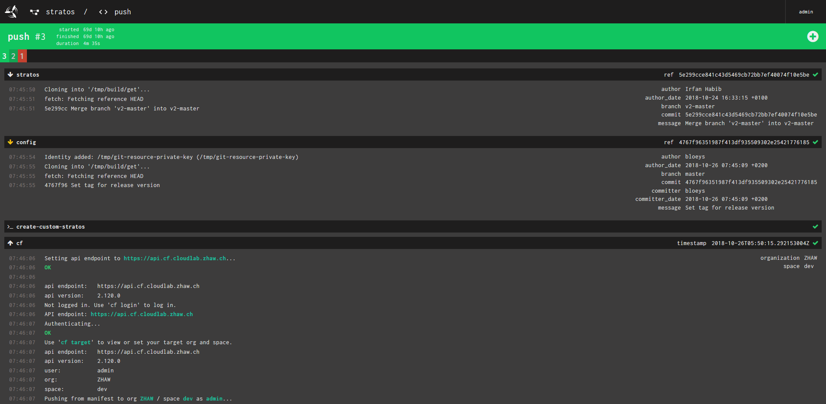
Job name
2 Git resources being cloned
Task
Output resource log (deploying an app)

Slide 26
More Information
These slides, some simple example pipelines and links to more Concourse learning resources can be found at: https://github.com/bloeys/cicd-via-concourse

